Slide 1


An intro to
Language Models

Slide 2
I know you all come for ChatGPT
How it works
Why it works

Slide 3
But,
ChatGPT is a large language model (LLM) which makes use of artificial neural networks to understand, interpret and analyze data.

Slide 4
Therefore,
First step to understand ChatGPT is to understand neural networks.

Slide 5
Learning objectives
Concepts
Understand some basic concepts in neural networks
feature, weight, bias, vector, matrix……
neuron, activation function, hidden layer……
Understand a neuron as a computation unit
Understand the fundamental algorithms underlying NNs
Hands-on computation
Know how to do matrix multiplication by hand

Slide 6
Roadmap
One neuron, one layer
Many neurons, one layer
Many neurons, many layers

Slide 7
Roadmap
What will be covered
The machine learning algorithms
What will not be covered
The optimization algorithms

Slide 8
Roadmap
neuron
One neuron
One layer
input
output

Slide 9
Roadmap
output
many neurons
one layer
input
output
output

Slide 10
Roadmap
output
output
many neurons
many layers
input
output
output

Slide 11
One neuron, one layer

Slide 12

Suppose you are looking to buy a home and would like to decide which houses are good and which houses are bad.

Slide 13


neuron
a house
or
You want a model that automatically takes in a house and outputs whether it is good or bad.
You get some training data, i.e. houses, and hand label them as good or bad based on your domain knowledge of house quality and feed the training data to the model to let it learn the rules.
After you find the best-performing model, you can apply it to new data, i.e. houses it has never seen before and let it decide whether the input house is good or bad!

Slide 14
Features
# of bedrooms
# of bathrooms
Age
… … …
… … …
neuron
or
Features

Slide 15
Not all features are alike
# of bedrooms
# of bathrooms
Age
… … …
… … …
The features differ in how much they influence the house being good or bad
Features

Slide 16
Weights
*
w_{bed}
w_{bath}
w_{age}
…
…
# of bedrooms
# of bathrooms
Age
… … …
… … …
*
*
Features
weights

Slide 17
Weights
*
# of bedrooms
# of bathrooms
Age
… … …
… … …
5
3
-2
…
…
sum up
For example
*
*
Features
weights

Slide 18
Bias
*
# of bedrooms
# of bathrooms
Age
… … …
… … …
5
3
-2
…
…
For example
+
10
*
sum up
*
Features
weights
+
Bias term

Slide 19
Formalism
# of bedrooms
# of bathrooms
age
Feature vector
Weight vector

Slide 20
Formalism
# of bedrooms
# of bathrooms
age

Slide 21
Vector multiplication

Slide 22
Formalism
# of bedrooms
# of bathrooms
age

Slide 23
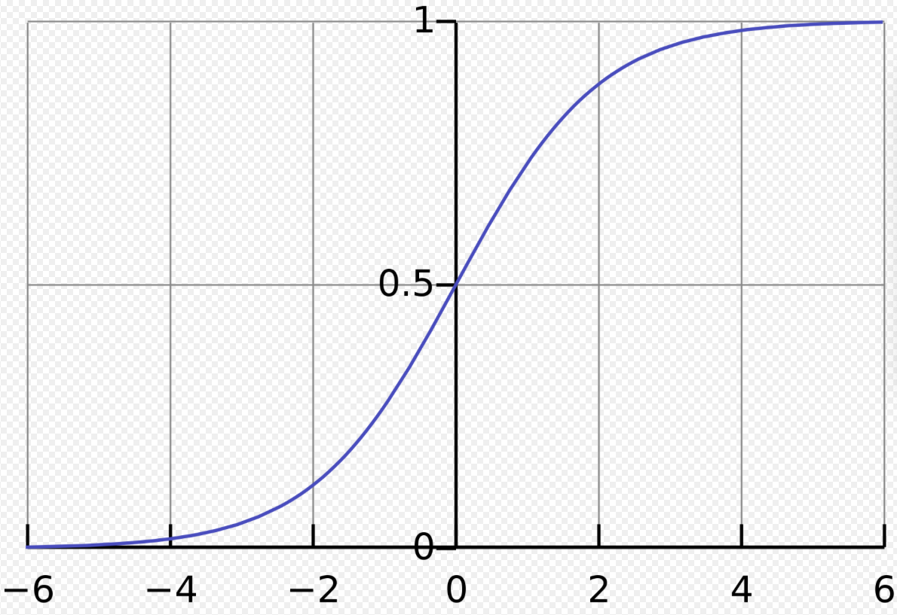

Sigmoid
(activation function)

Slide 24
Sigmoid
(activation function)
Raw score of a house
How likely the house is good
How likely the house is bad

Slide 25

Classifier
How likely the house is good
How likely the house is bad

Slide 26
Neuron as a computation unit
# of bedrooms
# of bathrooms
Age
… … …
… … …
neuron
or

Slide 27
Neuron as a computation unit
w ,b
neuron
𝛔
x
or
For each observation, the neuron outputs a prediction.
In our example, for each house, the neuron outputs a prediction as to whether the house is good or bad.

Slide 28
error/loss/cost
w ,b
neuron
𝛔
x
or
For each observation, the neuron outputs a prediction.
How does the prediction compare to the correct output?
error/loss/cost:
the distance between the predicted value and the correct value

Slide 29
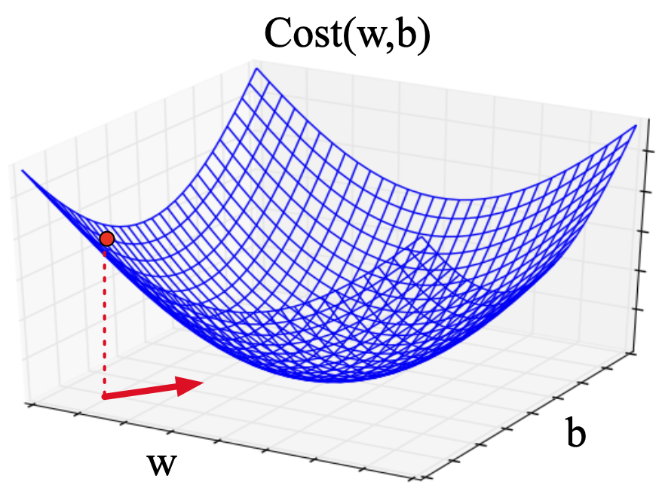
Minimize error
Our task reduces to calculating the values of the weights w and the bias term b such that the error is minimized!

Slide 30
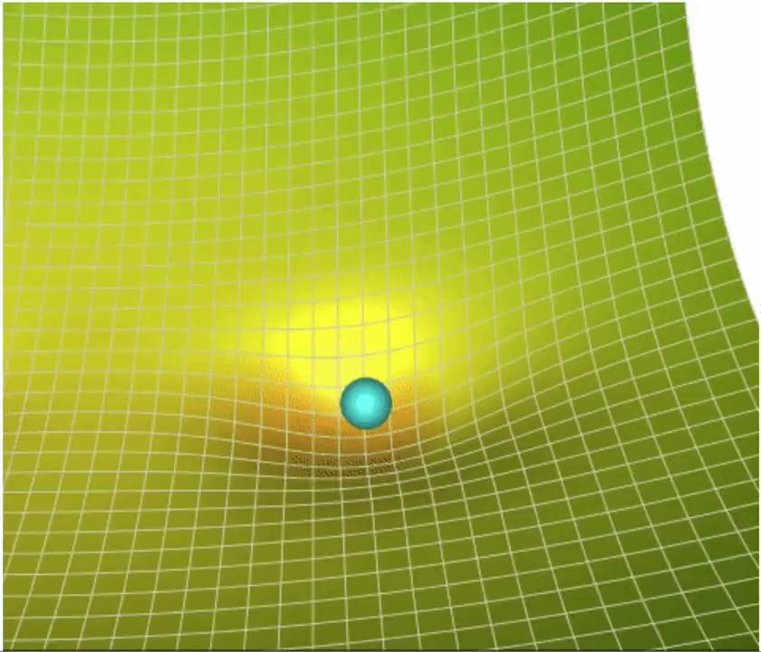
Gradient descent

Slide 31
Use cases
w ,b
neuron
𝛔
x
or
Sentiment analysis
Medical diagnosis
Period disambiguation
Spam detection

Slide 32
Binomial logistic regression
w ,b
neuron
𝛔
x
or
Binomial: outcome is dichotomous
Logistic: sigmoid is a logistic function
Regression: a statistical technique that relates a dependent variable (which, in our example, good or bad) to one or more independent variables (which, in our example, features of a house)

Slide 33
Exercise
Suppose we are doing binary sentiment classification of movie reviews. We’d like to assign a review to the positive class or the negative class.

Slide 34
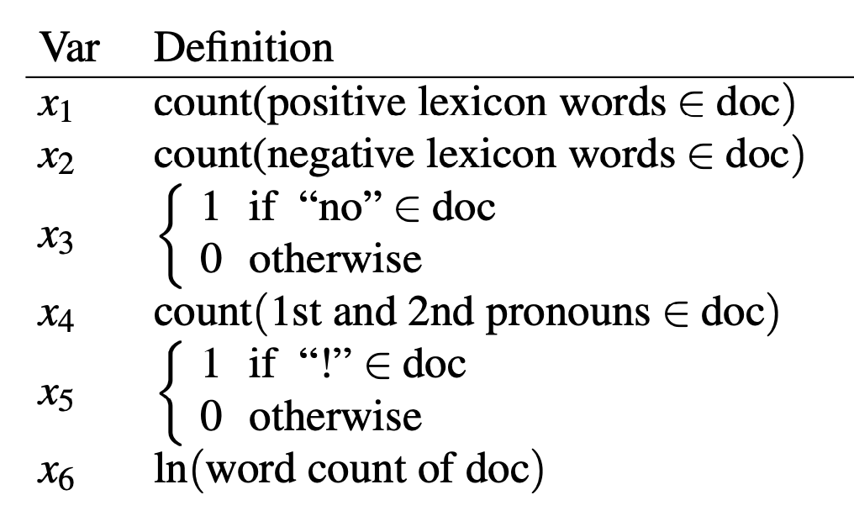
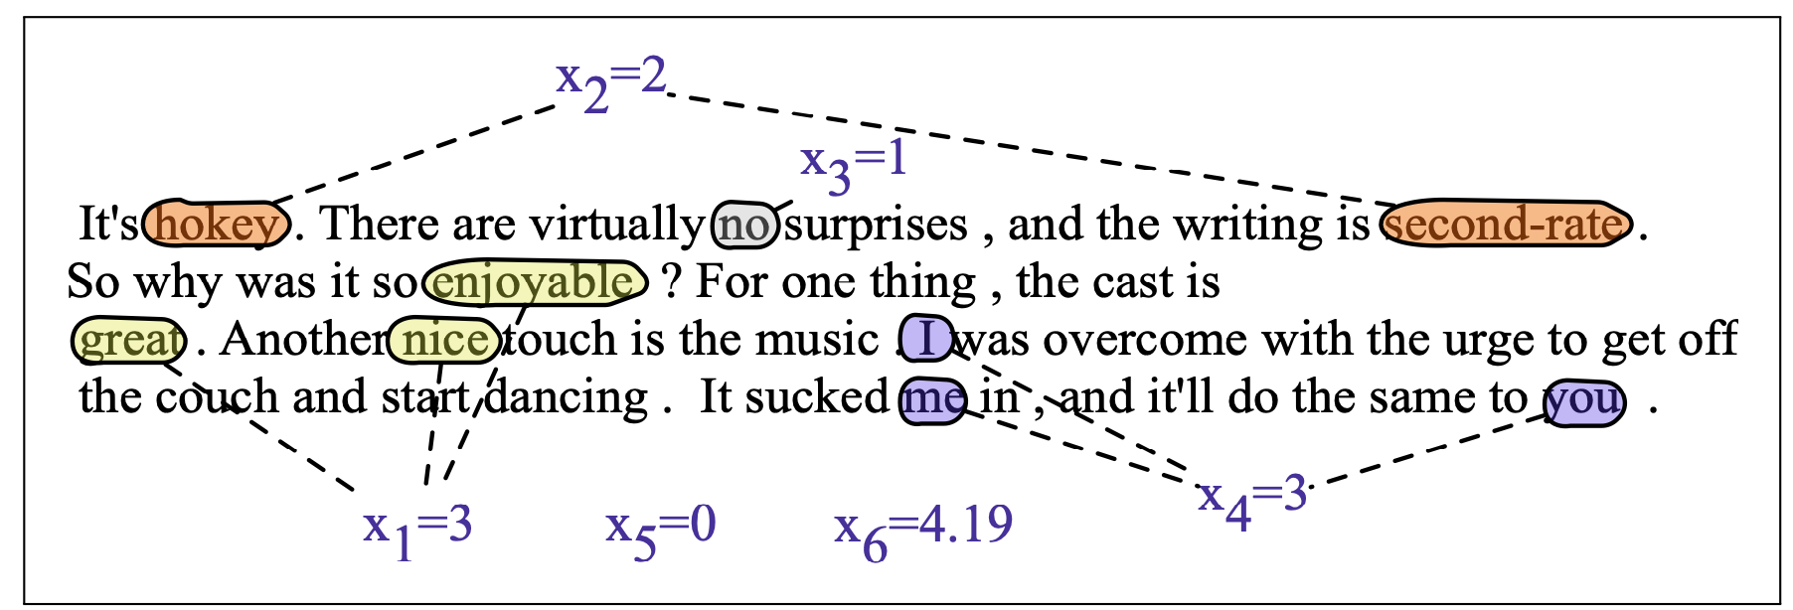

Exercise
features

Slide 35

Exercise
Suppose we have learned the values of the weights and the bias term

Slide 36
Exercise
Given the feature vector, weight vector and the bias term, do you know which class the binomial logistic regression model assigns the movie review to, positive or negative?
Steps to do this exercise:
Calculate a raw score for this review using the feature vector, weight vector and the bias term.
Use the sigmoid function(https://www.vcalc.com/wiki/vcalc/sigmoid-function) to calculate how likely the review is a positive review.
Use the decision boundary 0.5 to determine whether the review is a positive review or a negative review.

Slide 37
Any questions?

Slide 38
Many neurons, one layer

Slide 39
Recall that…

Slide 40
Binomial logistic regression
w ,b
neuron
𝛔
one neuron
one layer
x
or
Output is dichotomous

Slide 41
More than two classes
Suppose we would like to classify some movie reviews into one of three categories: positive, negative or neutral
Positive
many neurons
one layer
input
Neutral
Negative
Output has more than two classes

Slide 42
Multinomial logistic regression
Suppose we would like to classify some movie reviews into one of three categories: positive, negative or neutral
Positive
many neurons
one layer
input
Neutral
Negative
Output has more than two classes

Slide 43
Before…
w ,b
neuron
𝛔
x
or
Neuron as a computation unit

Slide 44
Now
w^{c1}, b^{c1}
softmax
n1
P_{Positive}
w^{c2}, b^{c2}
many neurons
one layer
n2
x
P_{Neutral}
w^{c3}, b^{c3}
n3
P_{Negative}
Each neuron is a computation unit!

Slide 45
If we have K classes…
K different classes, K different weight vectors and bias terms, each for one of the classes!

Slide 46

Stacked vectors as a matrix
Suppose we have n features for a given movie review. Since each feature has a weight associated with it, each neuron has a weight vector of length n.
Weight vector from first neuron, which corresponds to the first class

Slide 47
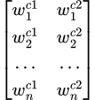
Stacked vectors as a matrix
Suppose we have n features for a given movie review. Since each feature has a weight associated with it, each neuron has a weight vector of length n.
Stacking the weight vectors of the first neuron
and the second neuron

Slide 48
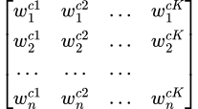
Stacked vectors as a matrix
Suppose we have n features for a given movie review. Since each feature has a weight associated with it, each neuron has a weight vector of length n.
Stacking the weight vectors from all K neurons

Slide 49
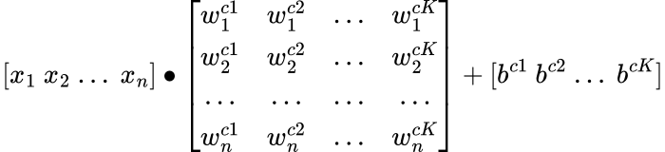
Given one observation…
w
b
x

Slide 50
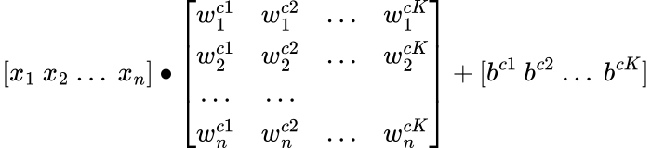
x∙w
w
b
x

Slide 51
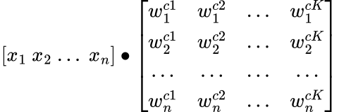
x∙w
w
x

Slide 52
x∙w
w
x

Slide 53
x∙w
w
w^{c1}
w^{c2}
w^{cK}
x
x⦁w^{c1}
x⦁w^{cK}

Slide 54
x∙w
w
w^{c1}
w^{c2}
w^{cK}
x

Slide 55
Given one observation…

Slide 56

Add the bias

Slide 57
Recall that…
w ,b
neuron
𝛔
one neuron
one layer
x
or
We compute a raw score x⦁w + b

Slide 58



Multinomial logistic regression
w^{c1}, b^{c1}
n1
w^{c2}, b^{c2}
many neurons
one layer
n2
x
w^{c3}, b^{c3}
n3
Each neuron is a computation unit!

Slide 59
Now what?
w^{c1}, b^{c1}
n1
w^{c2}, b^{c2}
many neurons
one layer
n2
x
w^{c3}, b^{c3}
n3
… …
… …
We have K raw scores, now what?

Slide 60
Before…
w ,b
neuron
𝛔
one neuron
one layer
x
or
We use the sigmoid function 𝛔 to squash all the house values to probabilities of being good or bad

Slide 61
Now
softmax
w^{c1}, b^{c1}
n1
P_{c1}
w^{c2}, b^{c2}
many neurons
one layer
n2
x
P_{c2}
w^{c3}, b^{c3}
n3
P_{c3}
… …
… …
We use the softmax function to squash all K values to probabilities

Slide 62
For example
softmax
w^{c1}, b^{c1}
n1
P_{Positive}
Back to the movie review example…
w^{c2}, b^{c2}
many neurons
one layer
n2
x
P_{Neutral}
w^{c3}, b^{c3}
n3
P_{Negative}
We use the softmax function to squash the 3 values to probabilities of being a positive, neural or negative movie review

Slide 63
Softmax
(activation function)
Softmax function
The softmax function takes a vector of K values [z₁, z₂, …z_{K}] , and maps the values to a probability distribution where each value is in the range (0,1) and the probabilities sum up to one.

Slide 64
Softmax
Softmax
w^{c1}, b^{c1}
n1
P₁
w^{c2}, b^{c2}
n2
x
P₂
sum up to 1
w^{c3}, b^{c3}
n3
P₃

Slide 65
error
Our task reduces to calculating the values of the weights w and the bias terms b such that the error is minimized!

Slide 66
Use cases
Multinomial logistic regression is appropriate for any situation where a limited number of outcome categories (more than two) are being modeled and where those outcome categories have no order.
Image classification
Voting choice in elections with multiple candidates
Career options by students
…

Slide 67
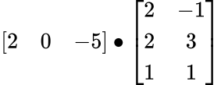
Exercise

Slide 68
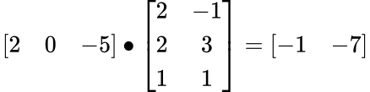
Answer

Slide 69
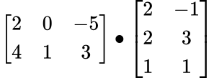
Exercise

Slide 70
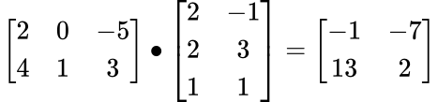
Answer

Slide 71
Interim Summary
Supervised Learning
Data -> ML algorithm -> Quality metric

Slide 72
Any questions?

Slide 73
Many neurons, many layers

Slide 74
Why more complicated neural networks?

Slide 75
A common task in NLP
Given a sequence of words, what is the most likely word that appears next?

Slide 76
In the house classification example, we use a feature vector to represent a house and use it to predict the house being good or bad
By analogy, we will need to use feature vectors of words to predict the next possible word in a sequence.
So, how do we derive the feature vectors of words?

Slide 77
We’ll introduce a model that derives feature vectors of words called skip-gram, a neural network that looks like …

Slide 78
Skip gram
output layer
o_{n1}
output
hidden layer
h_{n1}
o_{n2}
output
many neurons
many layers
input
h_{n2}
o_{n3}
output
h_{n3}
o_{n4}
output
… …
… …

Slide 79
Recall that…
w^{c1}, b^{c1}
Softmax
n1
P₁
w^{c2}, b^{c2}
n2
x
P₂
sum up to 1
w^{c3}, b^{c3}
n3
P₃
Each neuron has its own weight vector and bias term

Slide 80



Generalizing
g
f
o_{n1}
P₁
h_{n1}
o_{n2}
P₂
h_{n2}
x
sum up
to 1
o_{n3}
P₃
h_{n3}
o_{n4}
… …
P₄
… …

Slide 81
Skip-gram is much simpler!

Slide 82
Skip gram
No bias term in either the hidden layer or the output layer
No activation function in the hidden layer

Slide 83
Skip gram
Softmax
o_{n1}
P₁
h_{n1}
o_{n2}
P₂
h_{n2}
x
sum up to 1
o_{n3}
P₃
h_{n3}
o_{n4}
… …
P₄
… …

Slide 84
word2vec
Back to the task of deriving feature vectors of words

Slide 85
How to derive word vectors?
The distributional hypothesis: words that have similar context will have similar meanings
We’ll derive the vector representations of words from their context words!

Slide 86
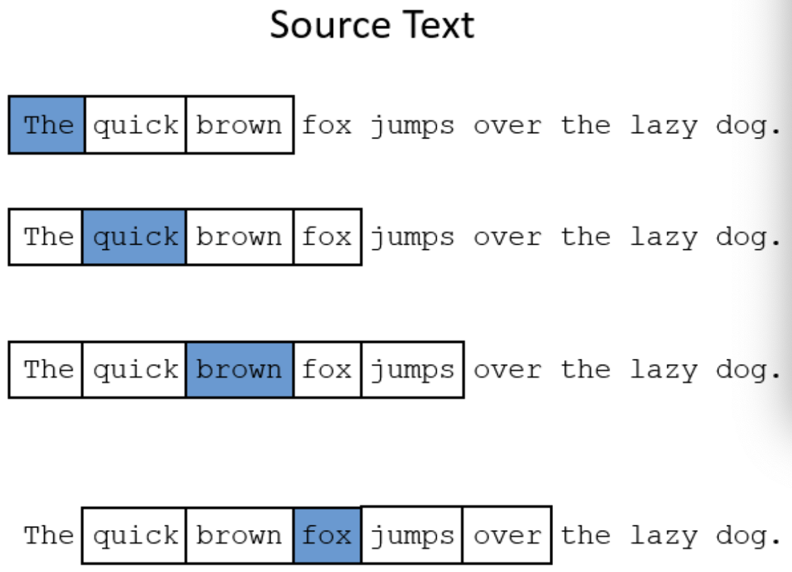
What is the context of a word?
context window size = 2

Slide 87
(Fake) task of skip gram
o_{n1}
word₁
“Given a specific word in the middle of a sentence (the input word), … The network is going to tell us the probability for every word in our vocabulary of being the ‘nearby word’...”
— Chris McCormick
h_{n1}
o_{n2}
word₂
Input word
h_{n2}
o_{n3}
word₃
h_{n3}
o_{n4}
word₄
… …
… …
… …

Slide 88
Real task of skip gram
o_{n1}
word₁
h_{n1}
o_{n2}
word₂
Learn the weights of the hidden layer, and use these weights as the vector representations of the words in the vocabulary
Input word
h_{n2}
o_{n3}
word₃
h_{n3}
o_{n4}
word₄
… …
… …
… …

Slide 89
For example
Given a target word, say, ‘ants’, we train a classifier. For each word w in the vocabulary, is w likely to show up near ‘ants’?
At the end, however, we don’t actually care about this prediction task; instead we’ll take the learned classifier weights as the word vectors.

Slide 90
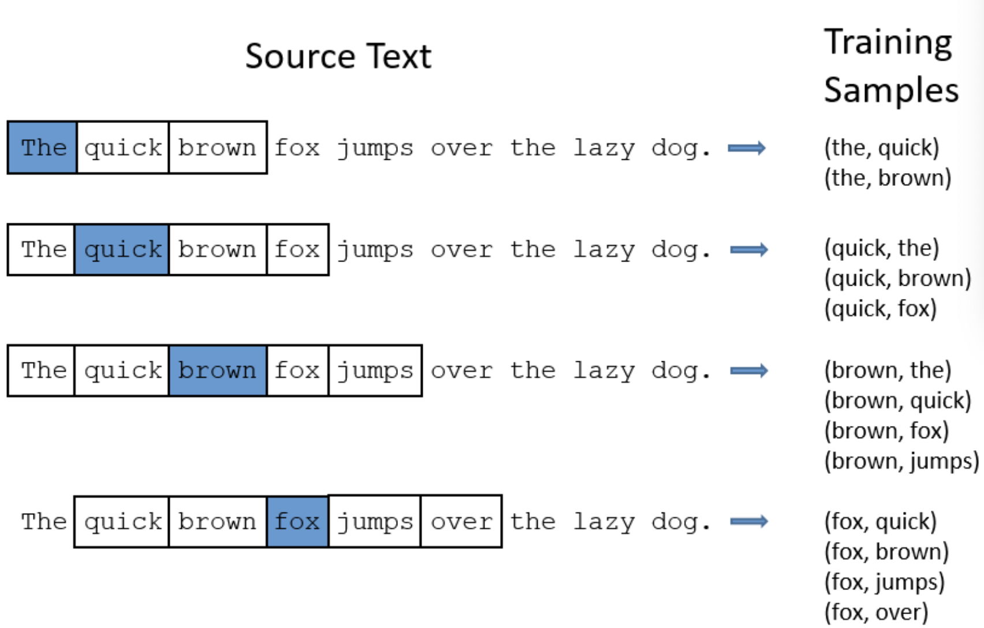
Skip gram

Slide 91
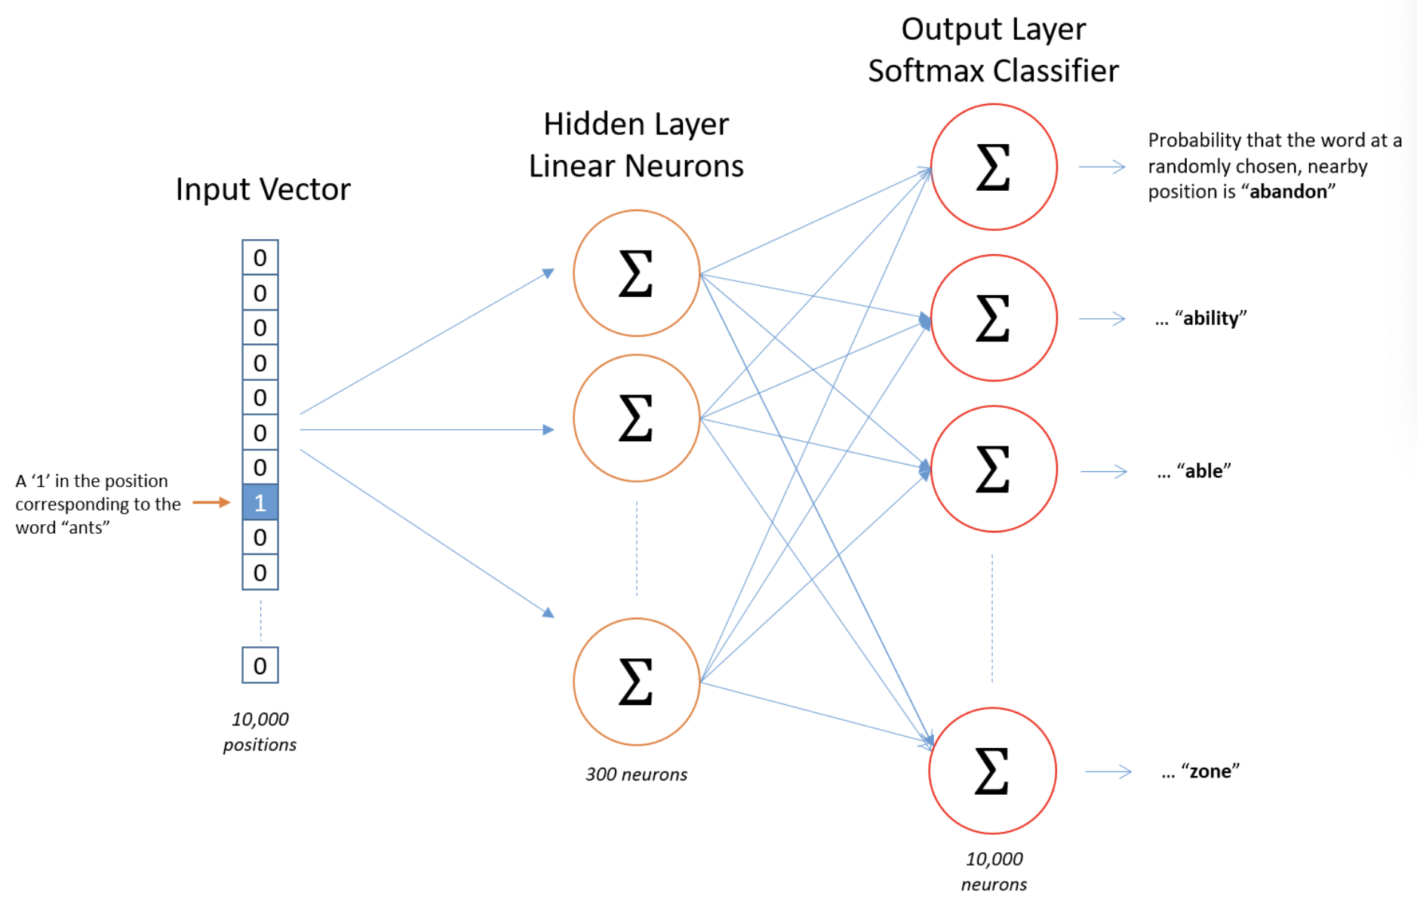
Skip-gram

Slide 92
One-hot vector
A vector with one value equal to 1 and all rest 0
For example,

Slide 93
Skip-gram
Vocab size: 10000
300 neurons in the hidden layer

Slide 94
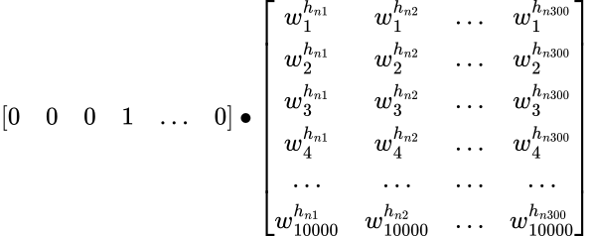
Given one input word

Slide 95
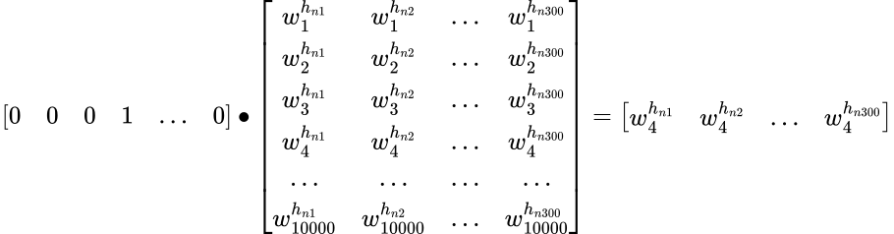
From input layer to hidden layer

Slide 96
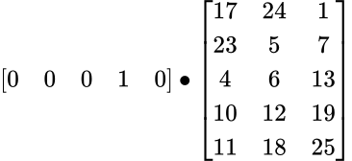
Exercise
What’s the effect of the one-hot vector?
Vocab size: 5
3 neurons in the hidden layer

Slide 97
A look-up table

Slide 98
word2vector

Slide 99
Skip-gram

Slide 100
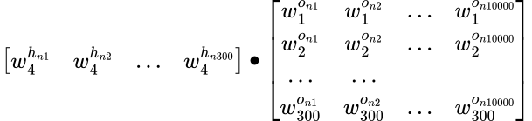
From hidden layer to output layer

Slide 101
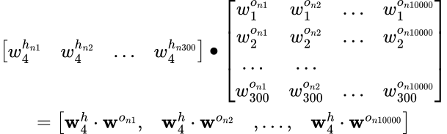
From hidden layer to output layer

Slide 102
Softmax
(activation function)
Softmax function
The softmax function takes a vector of K values [z₁, z₂, …z_{K}] , and maps the values to a probability distribution where each value is in the range (0,1) and the probabilities sum up to one.

Slide 103
Skip-gram

Slide 104
Minimize the error
When we calculate the outputs, we take in an input and go from the hidden layer to the output layer.
When we calculate the error to minimize it, we go from the output layer back to the hidden layer. This is called backward propagation of errors (backpropagation).

Slide 105
Any questions?

Slide 106
Learning objectives
Concepts
Understand some basic concepts in neural networks
feature, weight, bias, vector, matrix……
neuron, activation function, hidden layer……
Understand a neuron as a computation unit
Understand the fundamental algorithms underlying NNs
Hands-on computation
Know how to do matrix multiplication by hand

Slide 107
To be continued

Slide 108
TAP courses of interest
Finding word meaning through context: word embeddings
Spacy 3: machine learning, NER, text classification
And many more!!!
https://www.ithaka.org/constellate/text-analysis-pedagogy-institute/

Slide 109
References
Jiang, L. (2020). A Visual Explanation of Gradient Descent Methods (Momentum, Ada-Grad, RMSProp, Adam). June-2020. [online]. Available: https://towardsdatascience.com/a-visual-explanation-of-gradient-descent-methods-momentum-adagrad-rmsprop-adam-f898b102325c
Jurafsky, Daniel, and James H. Martin. (2023). Speech and language processing: An introduction to natural language processing, computational linguistics, and speech recognition.
McCormick, C. (2016). Word2vec tutorial-the skip-gram model. Apr-2016.[Online]. Available: http://mccormickml.com/2016/04/19/word2vec-tutorial-the-skip-gram-model.
Mikolov, T., Sutskever, I., Chen, K., Corrado, G. S., & Dean, J. (2013). Distributed representations of words and phrases and their compositionality. Advances in neural information processing systems, 26.

